Slide 1


Facebook
Social Network Evaluation
Shravya Mahankali

Slide 2
Facebook – How it is used?
Facebook is a social networking site made to keep in contact with the people we know all over the world.
It is used to share photos, videos including live telecasts, post updates sharing their current activities, feelings etc.
Everyone who creates an account has a profile or time line and a news feed.
When you post a photo or an update it will be displayed on your time line and on others whom you tag with.
You can send friend request to the people you know and can view your their updates on your news feed.

Slide 3
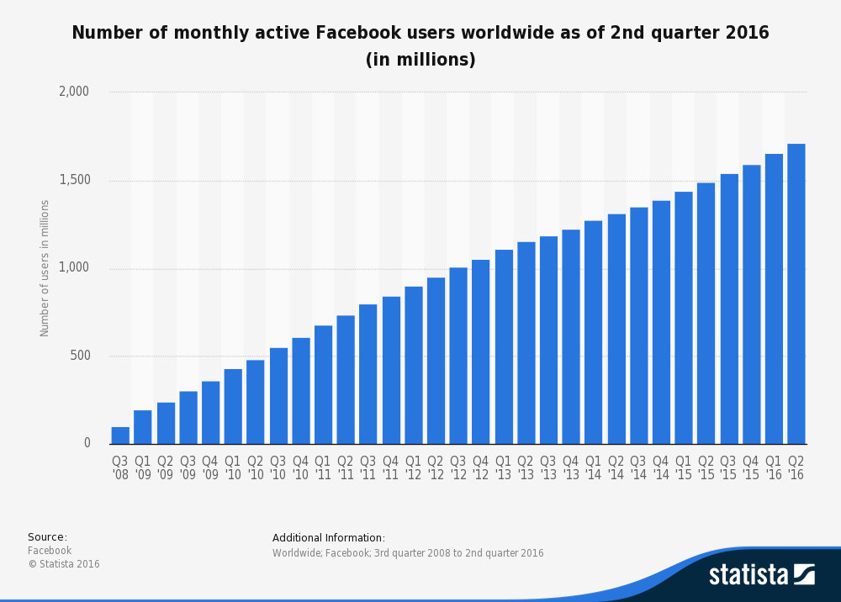
Statistics of face book users

Slide 4
Facebook – Terms of use policy
We agree to Facebook’s terms and policies by signing up into it.
Some of the users policies include minimum age, not sharing the account details with anyone, keeping passwords secured.
The user should agree for the following conditions when he signs up the facebook:
Facebook has all rights to delete any account if it causes any problems.
Facebook has all rights to retain all the information of the user and the posts he keeps and shares.
Even if the user deletes the post the company can retain archived copies of it.

Slide 5
Facebook – Privacy policy
Facebook can share user data with consent or as required by law.
Any user can block someone if he finds a problem with them.
We can also protect our posts from others by making them visible to only our friends.
Basically, people should take care while adding friends in our profile.
We can report abuse on any user if we want to take some action against them.

Slide 6
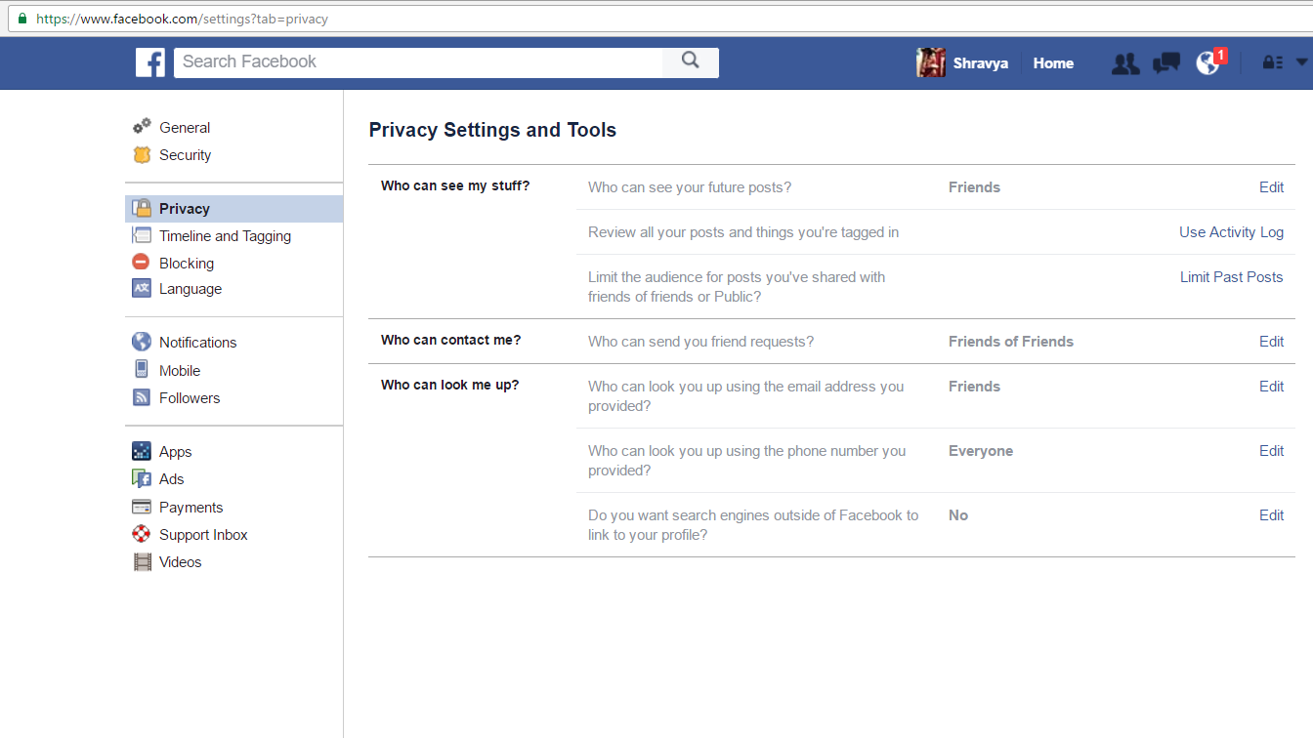
Facebook privacy settings

Slide 7
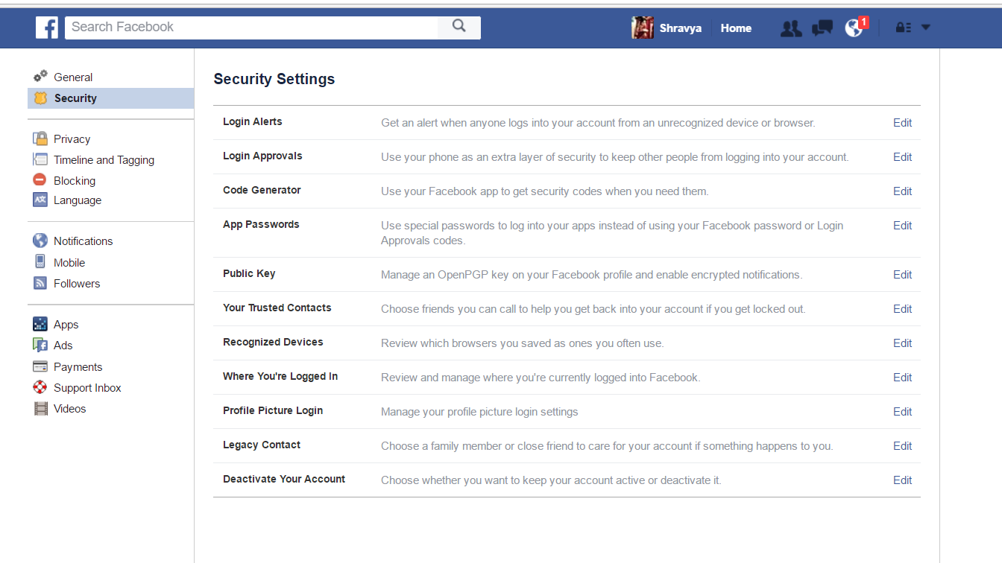
Facebook security settings

Slide 8
How they protect/share information
Facebook keeps track of all the information we share, view or text.
Facebook uses cookies or other similar technologies to collect data like posted information, from when and where the user has logged in etc.
Facebook collects all the data related to a operation we performed on it or using it.
Facebook even shares our personal information with third party applications.
They sell our information to other companies with our consent.
Facebook gives suggestion based on our browsing data which shows what kind of data it can collect.

Slide 9
Information we required to give
While signing up for facebook we need to give our:
First Name, Last Name, Mail Id, Password.
Birthdate, Gender.
We can share our phone number, photos, educational and professional information after signing up but these are not mandatory details.

Slide 10
Facebook – Social network ethics
One should know what information should be shared on face book and the awareness should be brought among the users.
By creating fake profiles there are chances of getting deceived easily.
Users personal information should not be exchanged with the other companies.
People should be careful while adding friends. They should not accept unknown friend requests.
Personal information should not be shared to everyone on facebook.

Slide 11
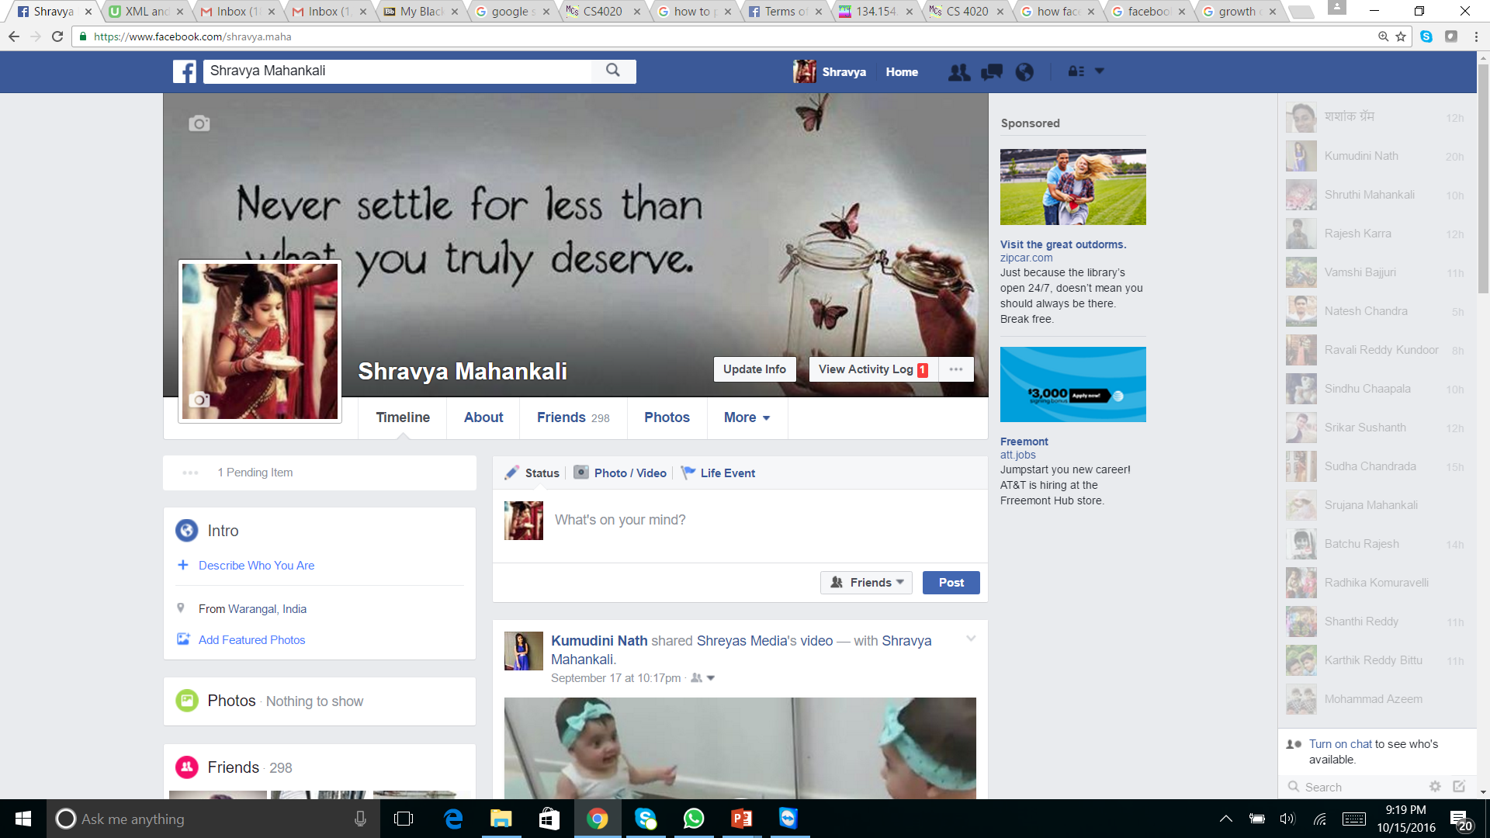
My Facebook profile

Slide 12
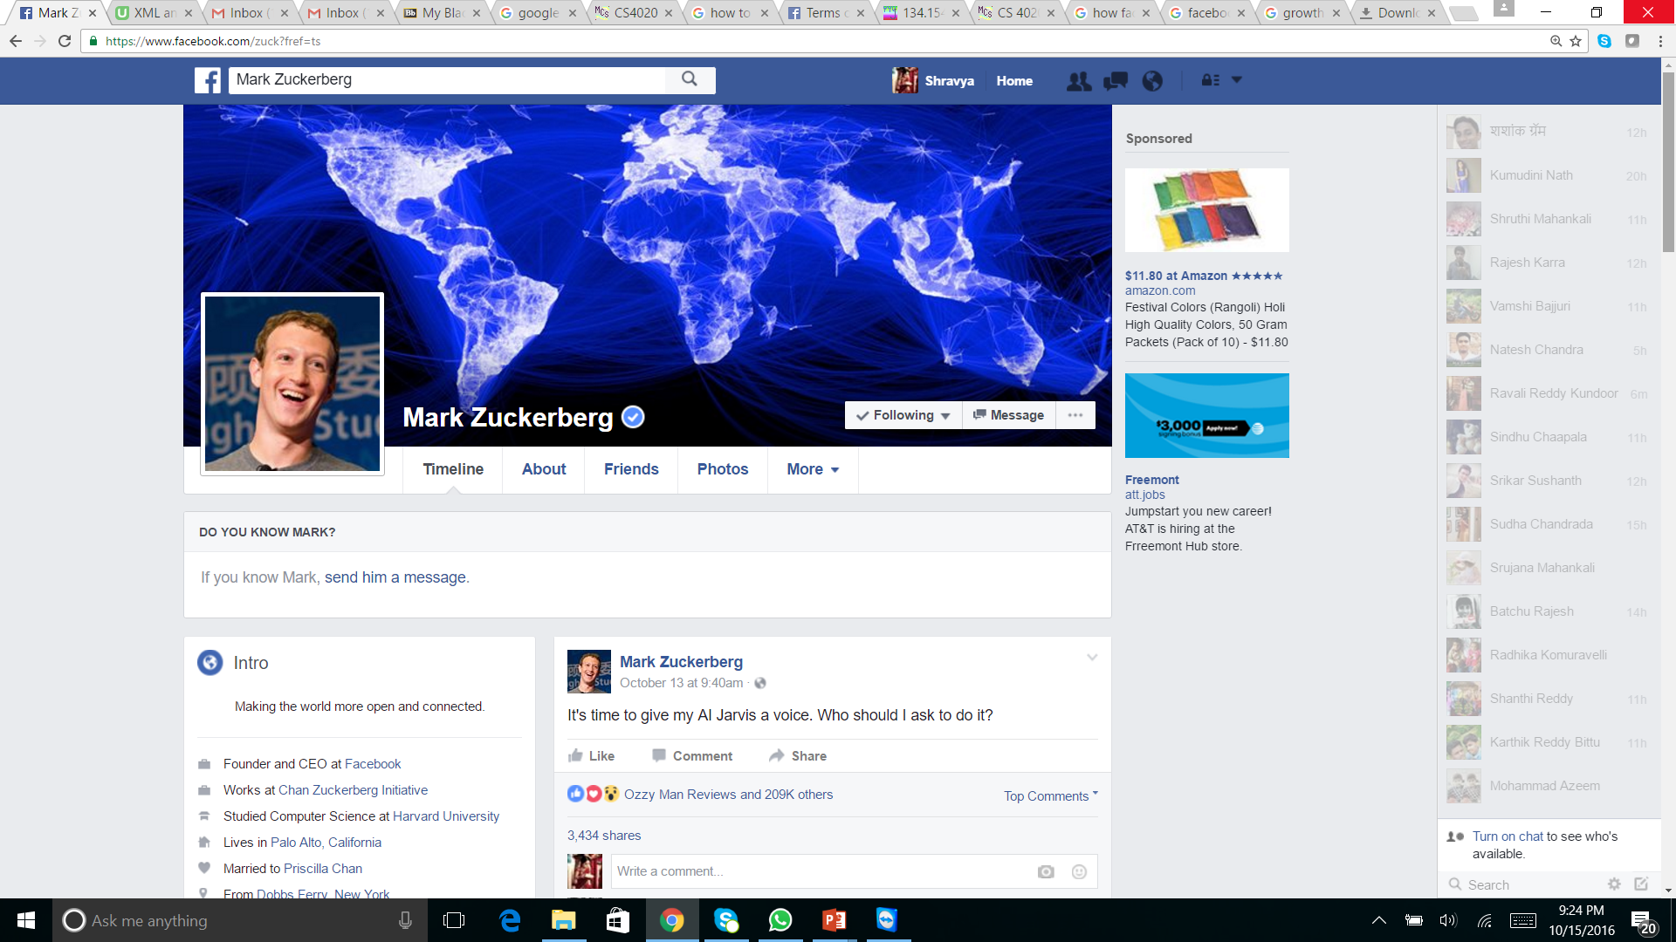
Facebook profile of a typical user

Slide 13
Thank you!!

